Slide 1

COMPUTER NETWORKS
S Nagasundari
Department of Computer Science and Engineering

Slide 2

COMPUTER NETWORKS
Unit – 5 Link Layer and LAN Roadmap
Introduction
Error detection, correction
Multiple access protocols
LANs
Addressing, ARP
Ethernet
Switches
A day in the life of a web request
Physical layer
Purpose, Signals to Packets
Analog Vs Digital Signals
Transmission Media
Wireless LANs: IEEE 802.11

Slide 3
COMPUTER NETWORKS
Class 53 : Intro to Physical layer : Learning Objectives
Purpose
Signals to Packets

Slide 4
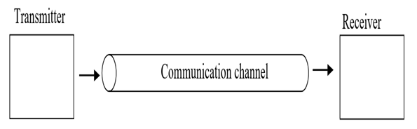
COMPUTER NETWORKS
Physical layer
Role:
encode the binary digits that represent data link layer frames into signals
to transmit and receive these signals across the physical media
copper wires, optical fiber, and wireless that connect network devices.
Physical medium : capable of conducting a signal in the form of voltage, light, or radio waves from one device to another.

Slide 5
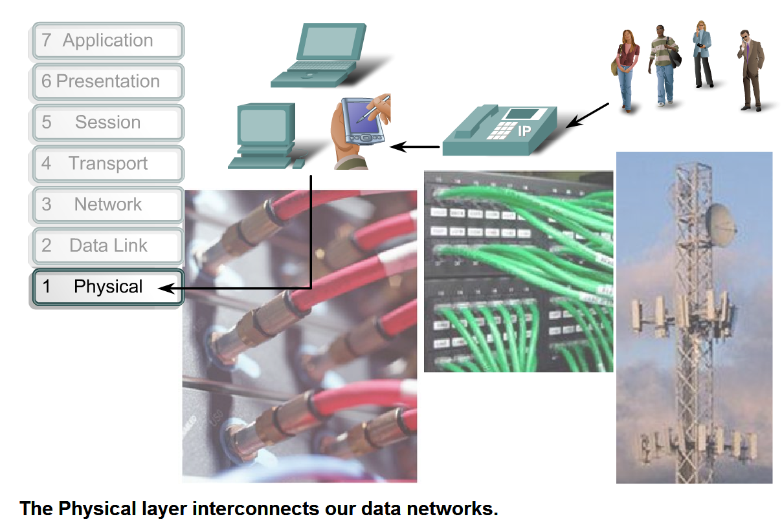
COMPUTER NETWORKS
Physical layer
The Physical layer consists of hardware, in the form of
electronic circuitry,
media, and
connectors.

Slide 6
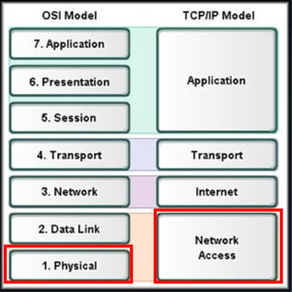
COMPUTER NETWORKS
Physical Layer
Purpose:
Primary Purpose:
Representation of the bits of a frame on the media in the form of signals
The physical media and associated connectors
Encoding of data and control information
Transmitter and receiver circuitry on the network devices

Slide 7
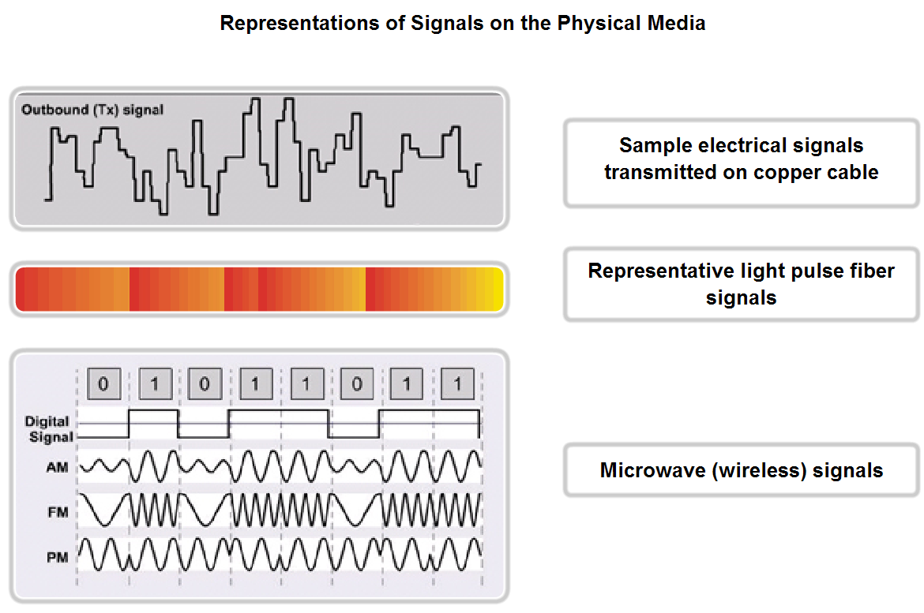
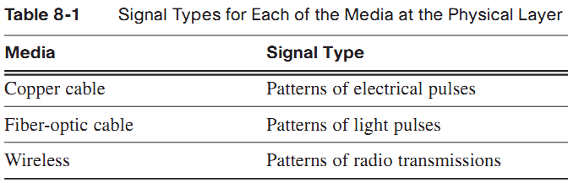
COMPUTER NETWORKS
Physical Layer Operation
Each medium has a unique method of representing bits (signaling)

Slide 8
COMPUTER NETWORKS
Physical Layer Operation
When the physical layer puts a frame out onto media, it generates a set patterns of bits, or signal pattern, that can be understood by the receiving device.
Many OSI Layer 1 technologies require the adding of signals at the beginning and the end of frames.
To mark the beginning and end of frames, the transmitting device uses a bit pattern that is unique and is only used to identify the start or end of frames.

Slide 9
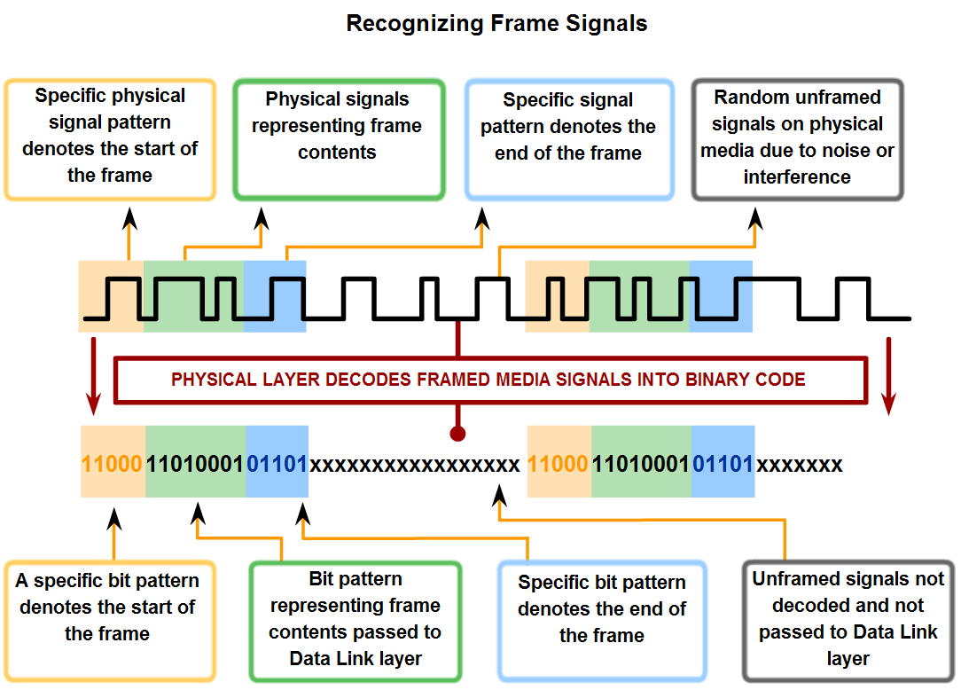
COMPUTER NETWORKS
Physical Layer Operation

Slide 10
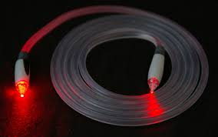
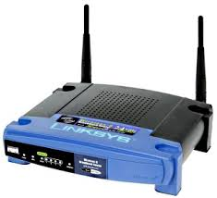
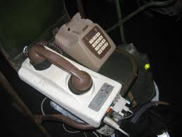
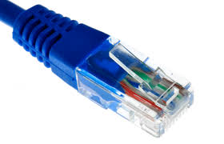
COMPUTER NETWORKS
Key Challenge
Digital computers
0s and 1s
Analog world
Amplitudes and frequencies

Slide 11
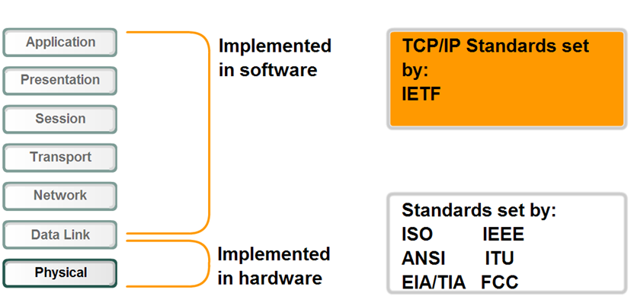
COMPUTER NETWORKS
Physical Layer Standards

Slide 12
COMPUTER NETWORKS
Physical Layer
Hardware components such as
network adapters (NICs),
interfaces and connectors,
cable materials
cable designs
Determine
Physical and electrical properties of the media
Mechanical properties (materials, dimensions, pinouts) of the connectors
Bit representation by the signals (encoding)
Definition of control information signals

Slide 13
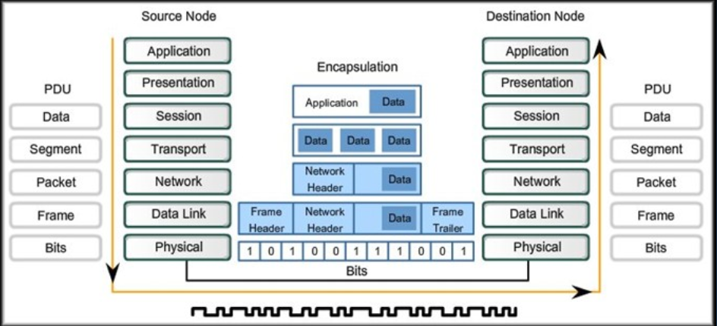
COMPUTER NETWORKS
Physical Layer
Encoded signal

Slide 14
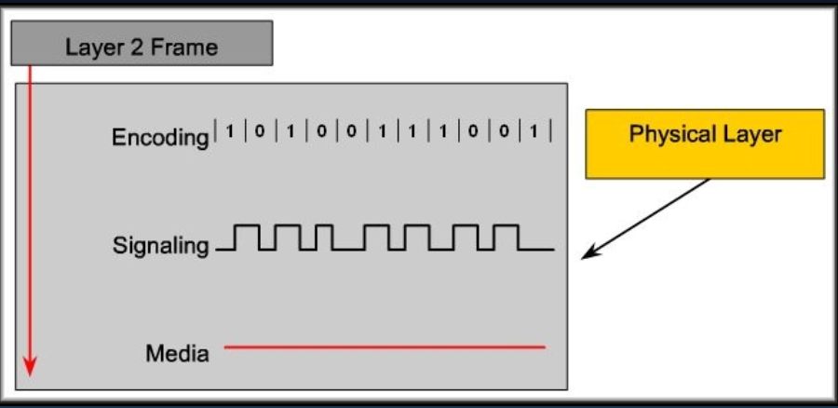
COMPUTER NETWORKS
Physical layer Fundamental Principles
The physical components
Data encoding-Computing the stream of data bits from higher layers into a predefined code
Signaling –Generation of the electrical/optical/wireless signals that represent the data bits

Slide 15
COMPUTER NETWORKS
Physical Signaling and Encoding : Representing Bits
Signaling Bits for the Media
All communication from the human network becomes binary digits, which are transported across the physical media
Transmission occurs as a stream of bits sent one at a time
Each of the bits in the frame represented as a signal
Bit time
Each signal has a specific amount of time to occupy the media
Each method finds a way to convert a pulse of energy into a defined amount of time
Time taken for a NIC at OSI Layer 2 to generate 1 bit of data and send it out to the media as a signal.

Slide 16
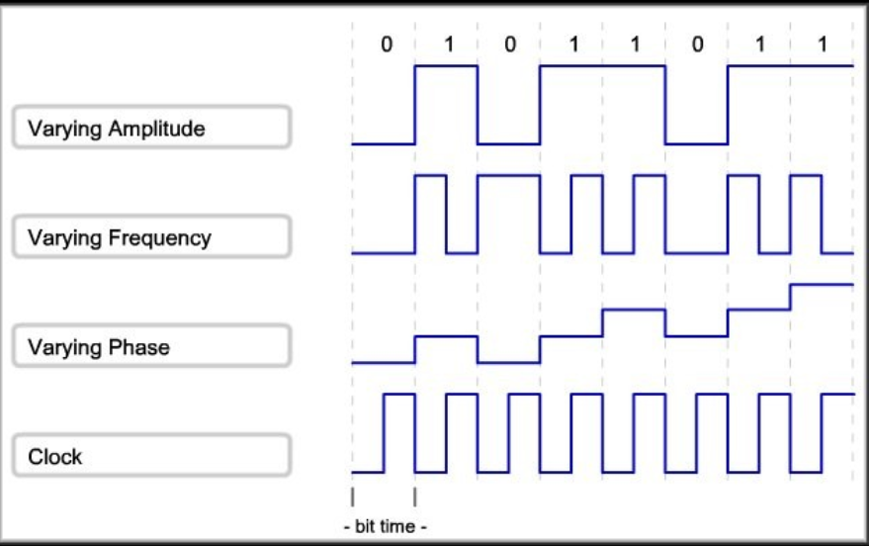
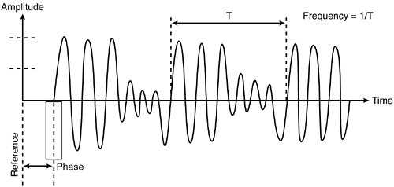
COMPUTER NETWORKS
Signaling Bits for the Media

Slide 17
COMPUTER NETWORKS
Assumptions
We have two discrete signals, high and low, to encode 1 and 0
Transmission is synchronous, i.e. there is a clock that controls signal sampling
Amplitude and duration of signal must be significant
Sample
Time

Slide 18
COMPUTER NETWORKS
Manchester
1 → high-to-low, 0 → low-to-high
0
0
1
1
0
NRZI
Clock
Good: Solves clock skew (every bit is a transition)
Bad: Halves throughput (two clock cycles per bit)

Slide 19
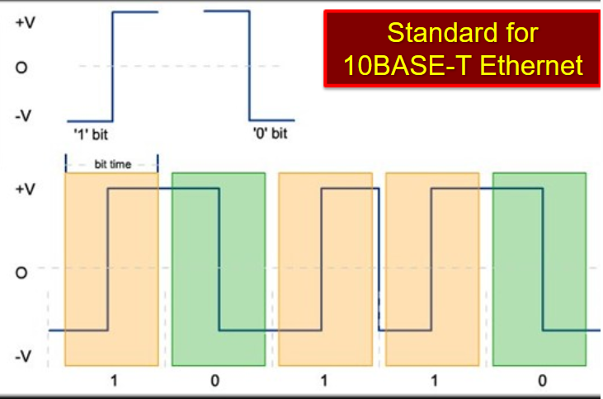
COMPUTER NETWORKS
Manchester Encoding
Manchester Encoding:
Uses the change in signal level in the middle of the bit time to represent the bits

Slide 20
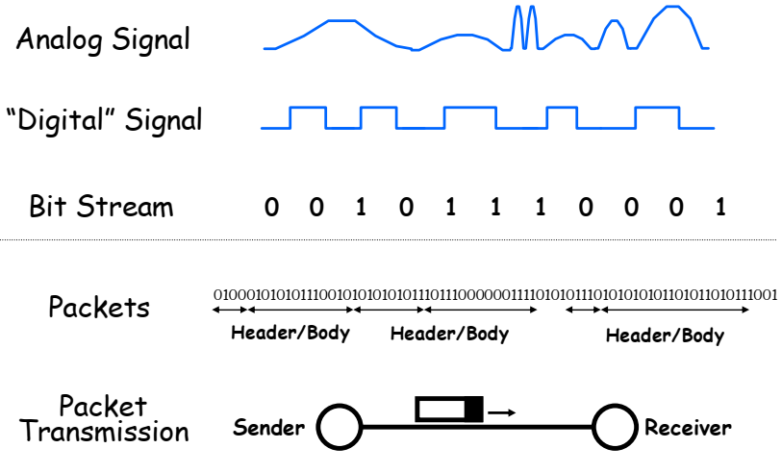
COMPUTER NETWORKS
Signals to Packets

Slide 21
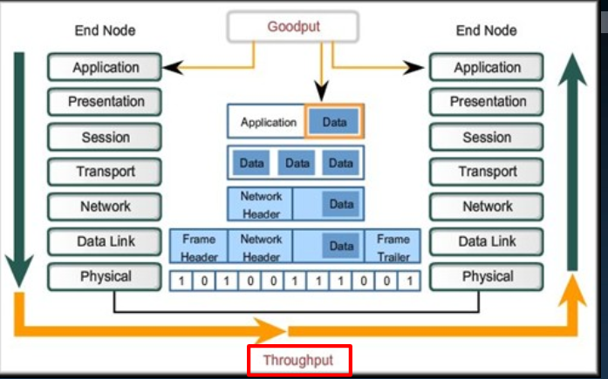
COMPUTER NETWORKS
Data Carrying Capacity
Bandwidth(Theoretical)
The capacity of a medium to carry data in a given amount of time
Takes into account the physical properties of the medium and the signaling method

Slide 22
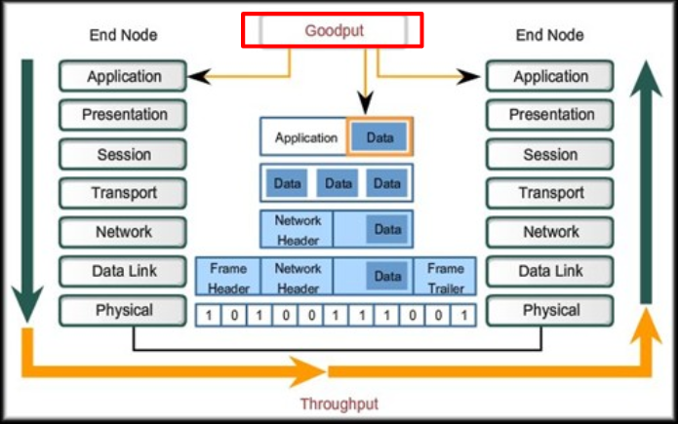
COMPUTER NETWORKS
Data Carrying Capacity
Throughput(Practical):
Transfer rate of data over the medium
Factors that affect: Amount and type of traffic, number of devices
Goodput( Qualitative):
Transfer rate of actual usable data bits
Throughput less the data protocol overhead, error corrections and retransmissions

Slide 23
THANK YOU
S Nagasundari
Department of Computer Science and Engineering
nagasundaris@pes.edu

